Slide 1
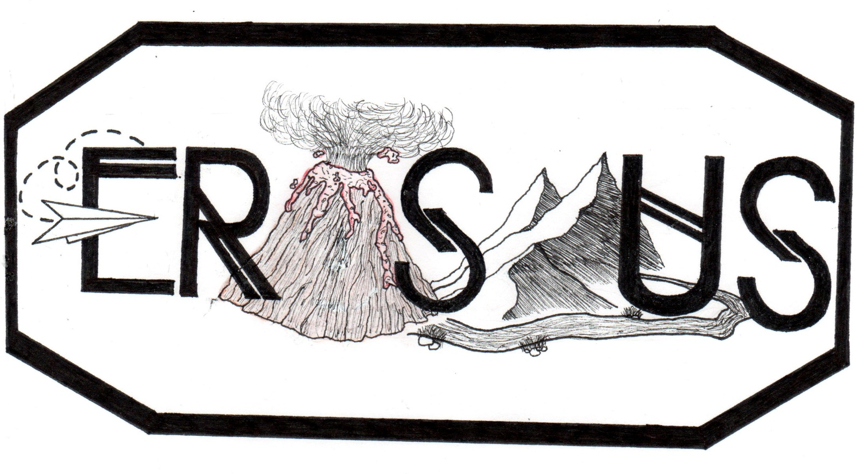
Jánošík,
the Slovak Robin Hood
We are where we live?!

Slide 2
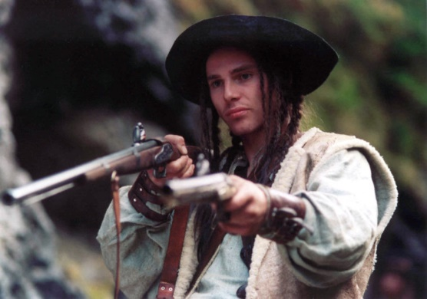
Jánošík is known as the Slovak Robin Hood, because according to legends , he robbed the rich and gave the booty to the poor.
Václav Jiráček in A. Holland´s film „ Janosik. A true story“ .

Slide 3
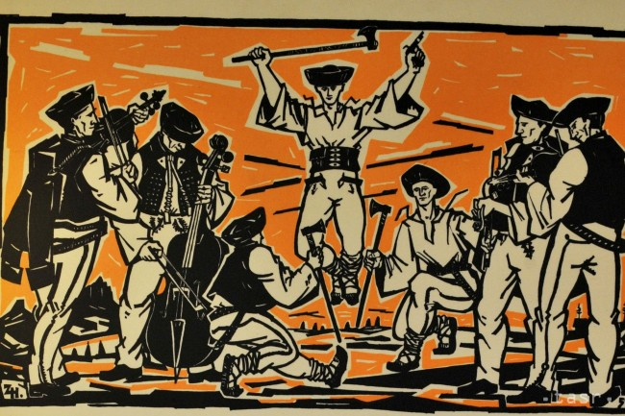
Jánošík was born in 1688 in Terchová in the Tatra mountains. He took part in the Rakoczi uprising against the Habsburgs. After suppressing the revolt he stayed a rebel and became the captain of a gang of robbers that took justice into their own hands by taking goods and money from rich aristocracy and giving it to the poor people.

Slide 4
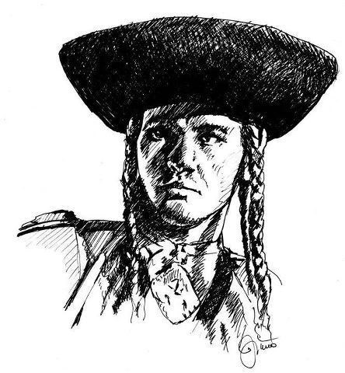
In the end he was captured, brutally tortured and sentenced to death by hanging . He was pierced by a hook through his left rib and hung from the tower for three days. Jánošík was only 25, when he died. He was a symbol for fighting for justice and independence.

Slide 5
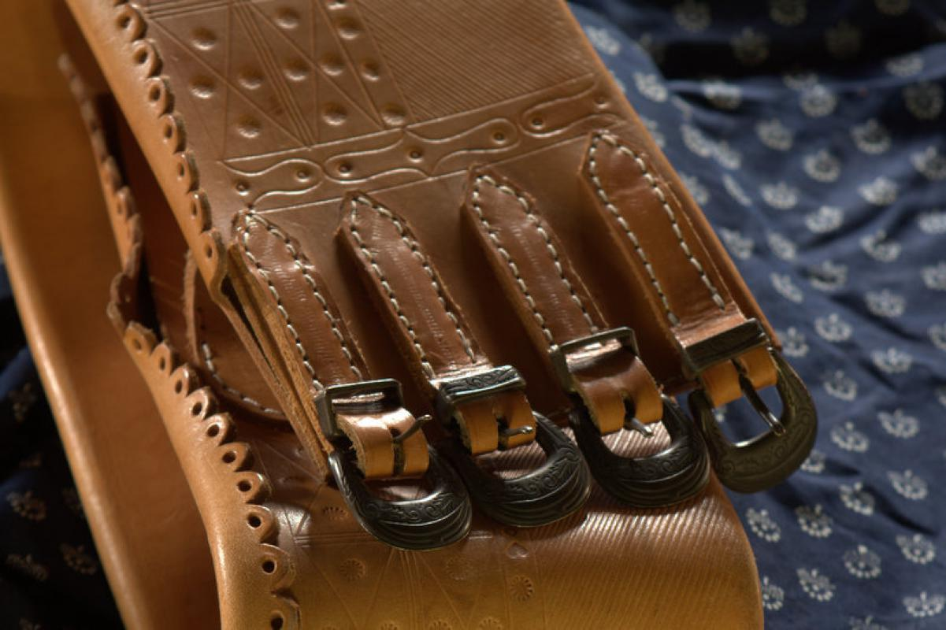
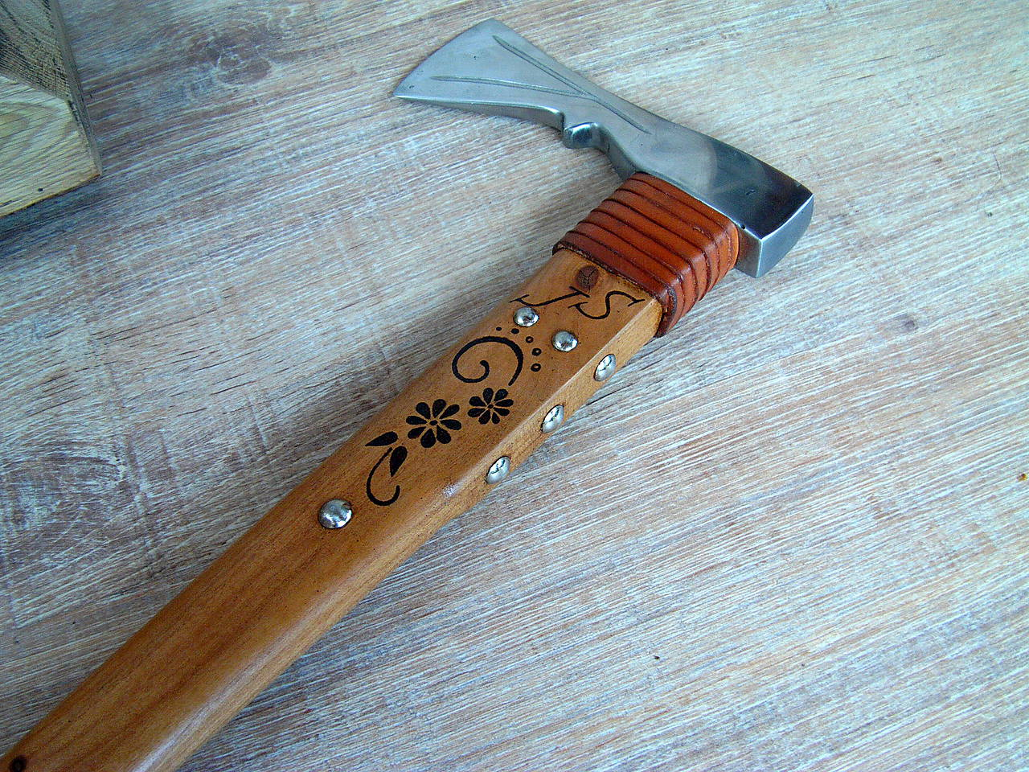
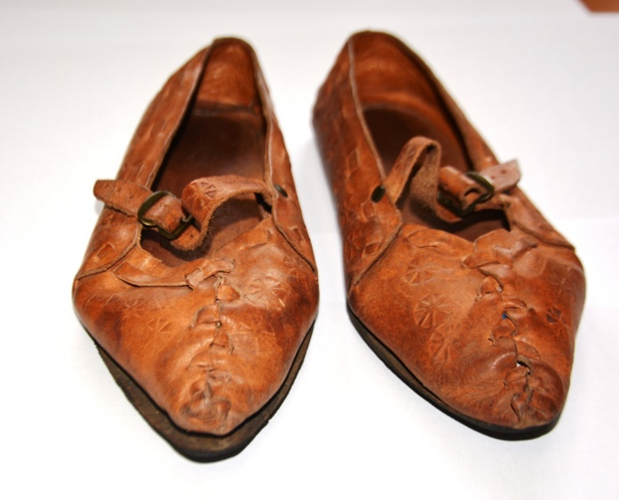
The legend of Jánošík is very popular in Slovak art. About Jánošík there are many poems, songs, books, films and even a musical called “ Painted on the Glass“ . Typical for his appearance were long braided hair, belt with iron bucket, ornameted axe, special hat and moccasins .

Slide 6
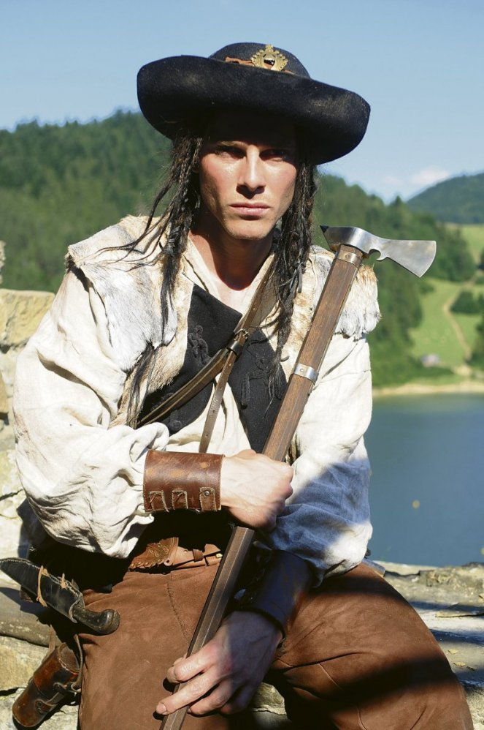
The legend of Jánošík contains all ingredients that a good story should have : there is a handsome young man, adventure, his magical skills, romantic love, martyrdom, early death, rebelling against the rullng class
„ Janosik. A true story. Film.“

Slide 7
Thanks for watching. Marianna Kováčová

